Slide 1
Data Visualization
The Good, The Bad and The Ugly

Slide 2
Agenda
Part-I
Introduction to data visualization basics
Best practices and bad practices in data visualization.
Examples and resources
Part-II
Basics of Matplotlib library.

Slide 3
Discussion: Why data visualization?
Hans Rosling - 200 countries 200 years
Common misconceptions (from Data Visualization: Reasons, not rules):
A picture is worth a thousand words.
Visualization is intuitive.
Data should speak for itself.
Show don’t tell
Notes:
With viz techniques we can capture more than 3D.
It allows us to see the patterns
Tell a story
We can fill-out this slide with students

Slide 4
Before you start a visualization
Ask yourself the following questions before you start your visualizations:
Why to visualize? (maybe a table is enough?)
What to visualize? (understand data, limitations, uncertainty, etc.)
Who to visualize? (audience, technical capabilities, accessibility?)
How much to visualize? (Where to cut data, what to include?)
How to visualize? (Pie Charts, bar charts, maps etc.?)
What style to use?
Source: Alberto Cairo - Data Visualization: Reasons, not rules
Notes:
What to visualize: Do you know your data and how is it collected? Units?
Who to visualize: Show, do tell! - Annotate the graphs appropriately.
How to visualize: alberto Cairo from 29:00 - 34:00

Slide 5
Reasons, not rules!
Know your question: What are you trying to answer? Do you have relevant data on hand?
Know your audience : Ask yourself who is your audience and what are their technical level. Here is another example.
Know your data : This will determine the best type of visualization technique to use. Here is another example:
Notes:
In the first link check 11:54 - 14:05

Slide 6
Common Patterns in Misleading Visualizations
Hiding relevant data
Showing too much data
Distorting the data

Slide 7
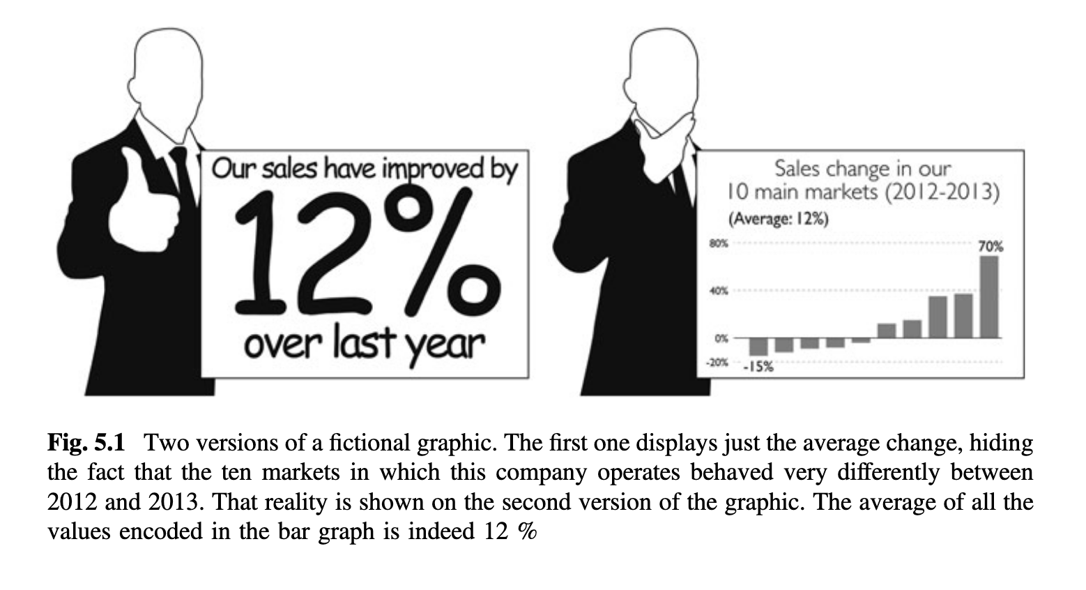
Not Showing Enough Data
Source: Graphic Lies, misleading visuals, Alberto Cairo

Slide 8
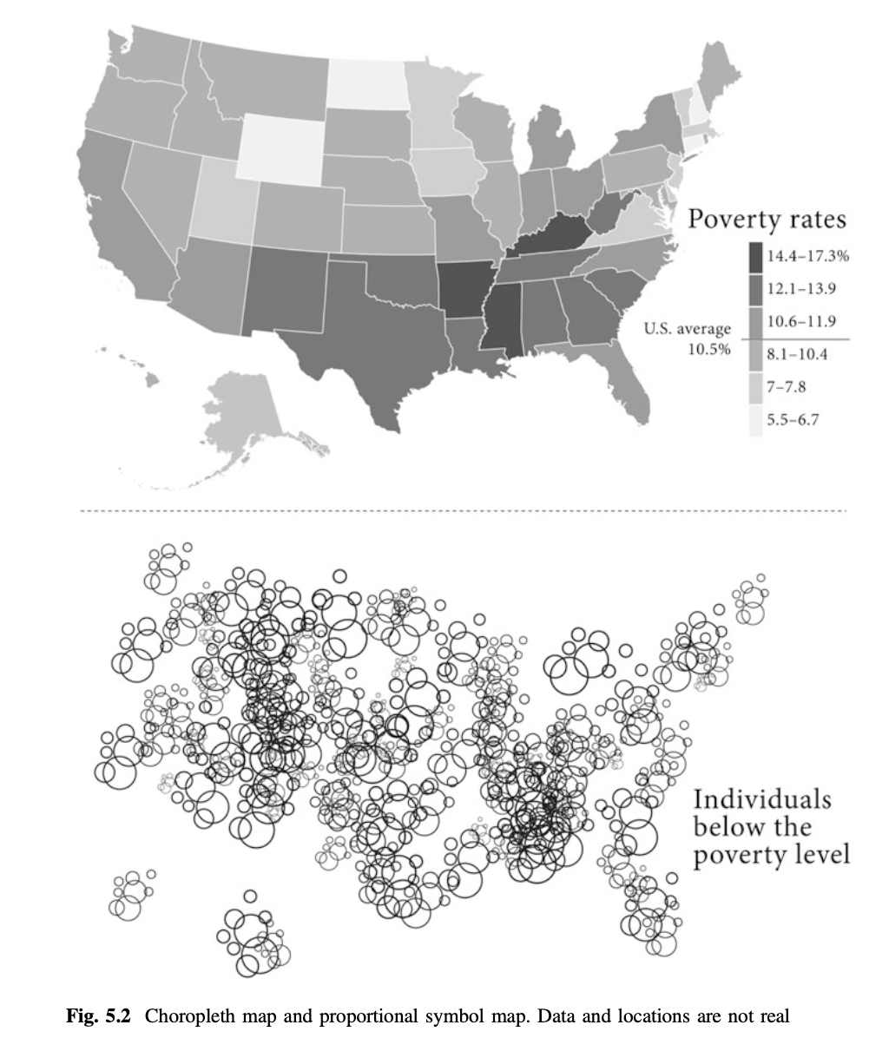
Displaying too much to obscure reality
Source: Graphic lies, misleading visuals by Albero Cairo.

Slide 9
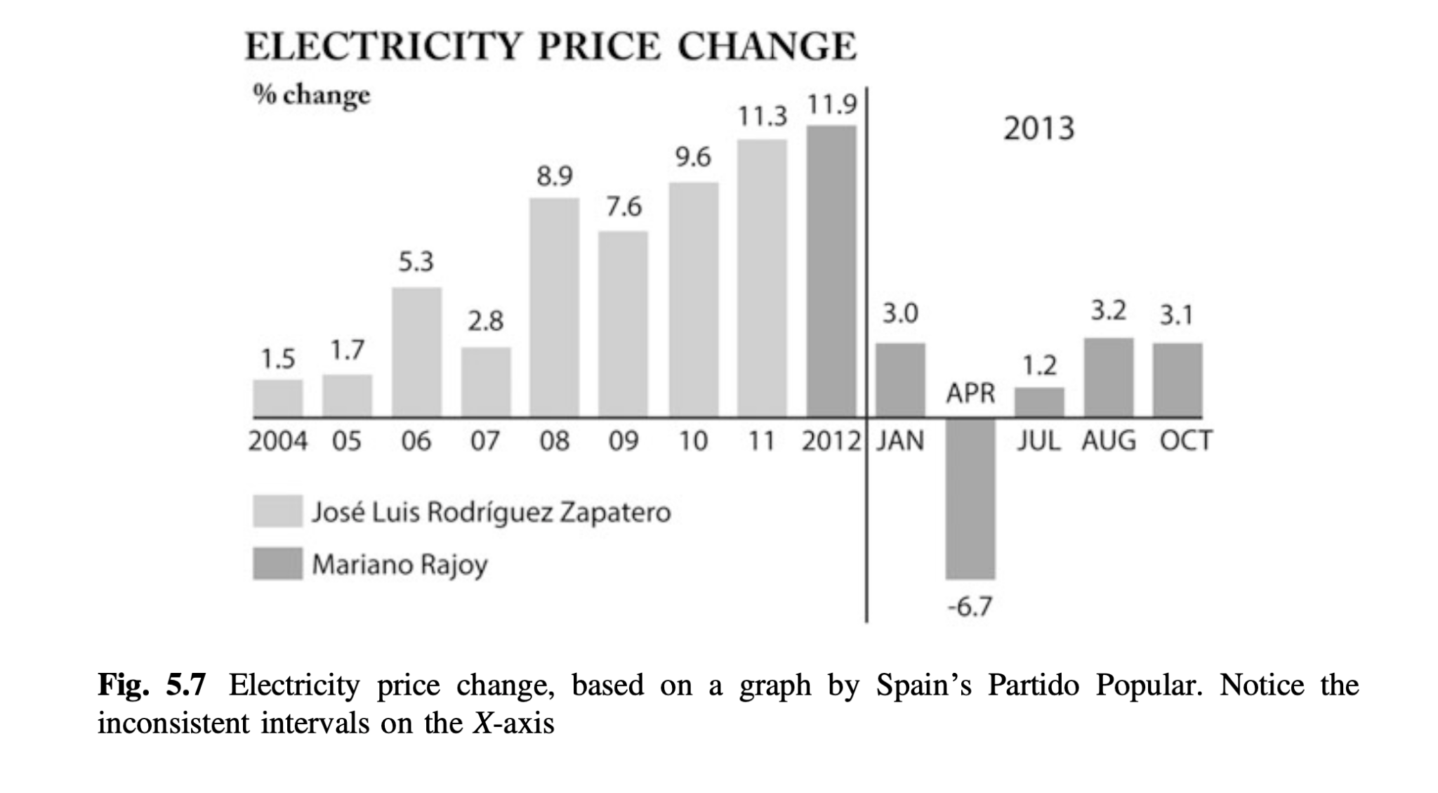
Distorting Data

